Slide 1
Functional Programming
Shane Carr
CSE 232, September 4, 2015

Slide 2
Upcoming Events
CodeSprint
Starts next week (September 11)
5 points of course credit
10 points of extra credit available
Teams of 1-3
Smaller teams don’t need to solve as many problems (1 problem per person for full credit)
ICPC Qualifiers
Saturday, October 3 (sign up by September 16)
15 points of course credit

Slide 3
Cut the Sticks: Language Breakdown

Slide 4
Cut the Sticks: Approach Breakdown

Slide 5
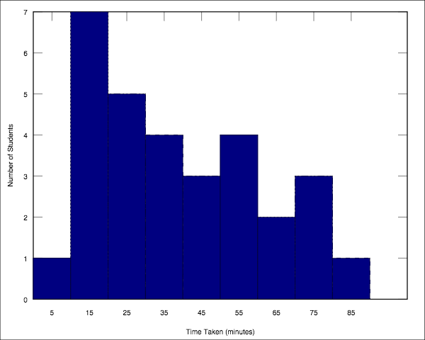
Cut the Sticks: Time Taken (minutes)

Slide 6
Functional Programming

Slide 7
What’s wrong with the following code?
// “strs” is a string array
// We want to get an array
// containing the lengths
// of the strings in “strs”
int[] result =
new int[strs.length];
for(int i = 0;
i < strs.length;
i++) {
String str = strs[i];
result[i] = str.length();
}
The code works.
We are telling the computer how to compute the result array.
What if we could tell the computer what we wanted to compute, and let the computer figure out the best way to do it?

Slide 8
Imperative vs. Functional
Imperative Programming
You tell the computer how to perform a task.
Functional Programming
You tell the computer what you want, and you let the computer (i.e. the compiler or runtime) figure out for itself the best way to do it.

Slide 9
Java 8: Lambdas and Streams
Lambdas
Like “mini functions”
Streams
Similar to lists, but provide functional programming constructs and perform lazy evaluation
// Convert List to Stream
// (constant time)
Stream<String> myStream =
myList.stream();
// Convert Stream to List
// (linear time)
List<String> myList =
myStream.collect(
Collectors.toList());

Slide 10
Functional Array Operations
Filter, Map, Reduce, and others

Slide 11
Filter Keep elements that pass a boolean test
// Java 7
List<String> result =
new ArrayList<String>();
for (String str : myList) {
if (str.length() > 5) {
result.add(str);
}
}
// Java 8
Stream<String> filtered =
myStream
.filter
(s -> s.length() > 5);
# Python (full syntax)
filtered = filter(
lambda s: len(s) > 5,
source)
# Python (shortcut syntax)
filtered = \
(s for s in source
if len(s) > 5)

Slide 12
Find Return one element satisfying a boolean test
// Java 7
String result = null;
for (String str : myList) {
if (str.length() == 5) {
result = str;
break;
}
}
// Java 8
Optional<String> result =
myStream
.filter
(s -> s.length() == 5)
.findAny();
# Python
filtered = next(
(s for s in source
if len(s) == 5),
"not found")
Note: Under the hood, Java 8 and Python both use lazy evaluation, so neither language traverses the entire stream if it finds a matching element early in the stream.

Slide 13
Map Transform elements by a common operation
// Java 7
List<Integer> lens =
new ArrayList<Integer>();
for (String str : myList) {
lens.add(str.length());
}
// Java 8
Stream<Integer> lens =
myStream
.map(s -> s.length());
# Python
lens = \
(len(s) for s in source)

Slide 14
Reduce Apply a binary operation to all elements
// Java 7
int totalLen = 0;
for (String str : myList) {
totalLen += str.length();
}
// Java 8
int totalLen =
myStream
.reduce(0,
(t,s) -> t + s.length(),
Integer::sum);
# Python
from functools import reduce
totalLen = reduce(
lambda t,s: t + len(s),
source, 0)

Slide 15
Convenience Reducers Min, Max, Sum, Average, Count, etc.
// Java 7
int totalLen = 0;
for (String str : myList) {
totalLen += str.length();
}
double avgLen =
((double)totalLen)
/ myList.size();
// Java 8
OptionalDouble avgLen =
myStream
.mapToInt
(s -> s.length())
.average();
# Python 3.4
from statistics import mean
totalLen = mean(
len(s) for s in source)

Slide 16
Collect Aggregate elements (for example, grouping)
// Java 7
Map<Integer,List<String>>
byLength =
new HashMap<Integer,
List<String>>();
for (String str : myList) {
int key = str.length();
if(!byLength.containsKey(key)){
byLength.put(key,
new ArrayList<String>());
}
byLength.get(key).add(str);
}
// Java 8
Map<Integer,List<String>>
byLength =
myStream.collect(
Collectors.groupingBy(
String::length));
# Python
# caveat: requires a sorted
# list before grouping
totalLen = groupby(
source,
key = lambda s: len(s))

Slide 17
Flat Map Do a map and flatten the result by one level
// Java 7
List<Character> chars =
new ArrayList<Character>();
for (String str : myList) {
for(char ch : str.toCharArray()){
chars.add(ch);
}
}
// Java 8
Stream<Character> chars =
myStream
.flatMapToInt
(s -> s.chars())
.mapToObj(i -> (char) i);
# Python
chars = \
(p for q in (
list(s) for s in source
) for p in q)

Slide 18
Sorting Example: Sort strings by length (longest to shortest) and then alphabetically
Java 8
Python
Stream<String> result =
myStream
.sorted(
Comparator
.comparing(String::length)
.reversed()
.thenComparing(
Comparator
.naturalOrder()
)
);
# Python
result = sorted(
source,
key = lambda s: (
-len(source),
source
)
)

Slide 19
Other Stream Methods
Concat
Takes two streams and lazily appends them together
Distinct
Removes duplicate elements
For Each
Perform an operation on each element
Limit
Truncate the stream to a given length
Generate
Create an infinite stream by evaluating a lambda function whenever a new element is requested
Reverse
Reverse the stream
Skip
Remove the first n elements
Zip
Iterate over two streams at the same time

Slide 20
Chaining Stream Methods

Slide 21
Side-by-Side Comparison
Imperative
Functional
Maintains state.
Manually parallelizable.
More code.
Less intuitive.
Runtime exceptions, like NullPointerException.
Stateless.
Automatically parallelizable.
Less code (usually).
More intuitive.
More errors caught at compile time.

Slide 22
Functional programming is like describing your problem to a mathematician. Imperative programming is like giving instructions to an idiot.
—arcus

Slide 23
How to start thinking in the functional style
Avoid “for” loops
If you find yourself using one, there’s probably a better way to do what you want.
Use fewer variables
See if you can connect multiple steps together into an expressive “chain” of method calls.
Avoid “side effects”
When you run a function, it shouldn’t inadvertently change the value of its input or some other variable.

Slide 24
Language Support
Languages designed for functional programming
Languages with good functional support
Haskell (1990)
Erlang (1986)
Mathematica (1988)
Elm (2012)
Lisp (1958), including dialects like Clojure (2007) and Scheme (1975)
JavaScript (1997)
Java 8 (2014)
C++11 (2011)
Python (1991)
Ruby (1995)
Scala (2003)
Julia :D (2012)

Slide 25
Why has Functional Programming not been more popular in industry?
Lack of Knowledge Base
Most people learn imperative programming first and get comfortable in that programming style
People who’ve never seen the functional programming style before think it’s unreadable
This is starting to change, with more and more schools teaching it in their intro classes (MIT, Yale, UC Berkeley, and others)
Lack of Mainstream Compilers
Functional programming has been around since the ’50s, but has mostly been confined to niche languages like Haskell and Lisp
The JDK added support last year (2014)

Slide 26
Advanced: More on Java 8 Lambda Functions
Not Just One Type
Depending on the relationship between the argument and return types, lambda functions can be one of many types.
To name a few:
Predicate<T> takes a T and returns a boolean
BinaryOperator<T> takes two T’s and returns a T
BiFunction<T,U,V> takes a T and a U and returns a V
Lexical Scoping
Lambda functions make a closure over the scope in which there are declared in code, which is common in other languages but is new in Java 8.
Optionals
In order to avoid returning “null” values, Java 8 has a new Optional<T> type, having methods like:
ifPresent( lambda )
orElse( alternate value )

Slide 27
Live Code

